Slide 1
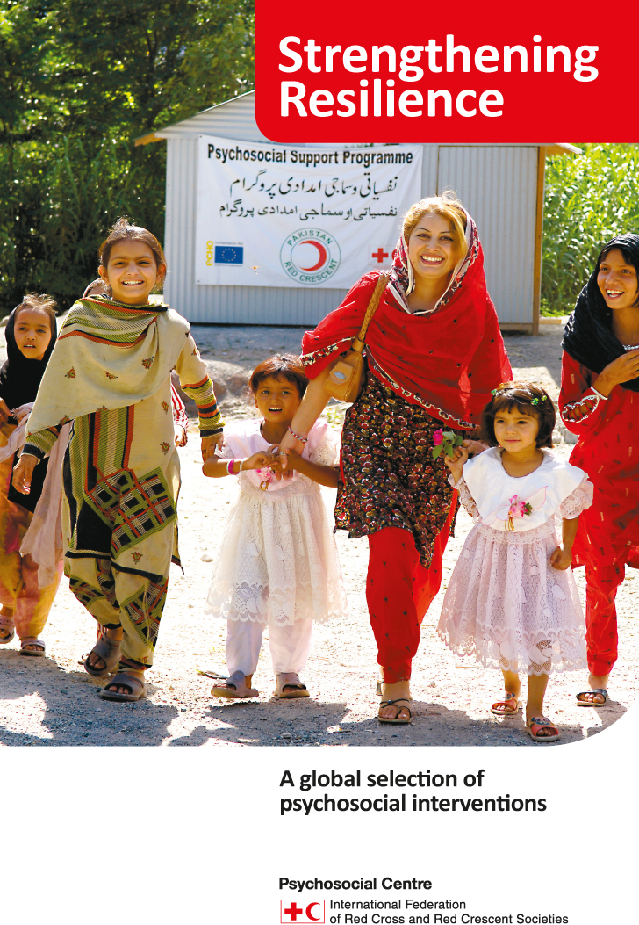

Slide 2
Why provide MentaL Health and psychosocial support?
To strengthen:
Resilience – the ability to bounce back after something difficult has happened, or to get through difficult experiences in a positive way
Coping mechanisms - the ability to deal with challenges and difficult situations
Restoring social cohesion – networks and structures

Slide 3
What is psychosocial support?
Psycho- logical
Social/ cultural
Feelings
Emotions
Thoughts
Beliefs
Perceptions
Behavior
Traditions
Values
Upbringing
Relationships
Family
Community

Slide 4
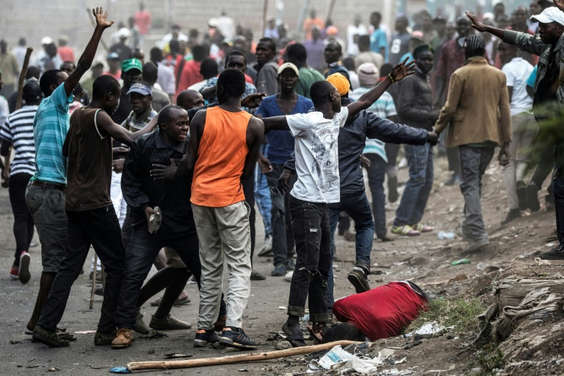
Difficult life circumstances

Slide 5
Factors influencing life
Protective factors literally ‘protect’ people, reducing the impact of hardship and difficulties
Risk factors literally put people ‘at risk,’ increasing the impact of hardship and difficulties

Slide 6
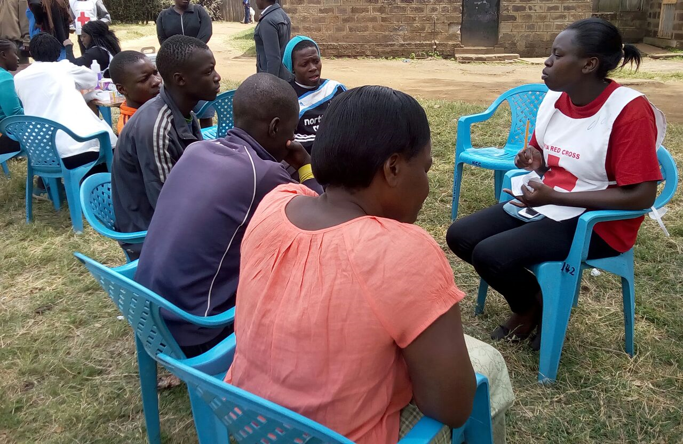
Coping and Assisting

Slide 7
Personal resilience qualities
Ability to make realistic plans and carry them out
Having a positive image of oneself
Feeling self-confident
Having the ability to adapt easily to new situations
Being able to deal with strong emotions
Being able to communicate feelings and thoughts
Believing that change can happen

Slide 8
Key points in assisting young people
Clarify the problem and provide relevant practical information
Support the young people in identifying possible solutions
Deal with the ‘here and now’
Accompany, support and coach, rather than giving direct advice
Provide PFA

Slide 11
THE IFRC REFERENCE CENTRE FOR PSYCHOSOCIAL SUPPORT
A Centre of Excellence
Established in 1993. Hosted by Danish Red Cross in Copenhagen
Develops models, tools and case studies reflecting best practice in community-based mental health and psychosocial support
Works under the framework of the International Federation of the Red Cross and Red Crescent (IFRC)
Supports National Societies in their operational assistance to international mental health and psychosocial programmes​
Supports, promotes, and advocates for the awareness and implementation of Mental Health and Psychosocial Support (MHPSS)
Communicates complex research findings in easy-to-understand ways
Assists National Societies in providing community-based MHPSS to vulnerable groups and volunteers
Cooperates with other humanitarian organizations providing MHPSS to exchange materials and experience

Slide 12
Links and emails to go to
Email to MHPSS IFRC Africa: Basilio.muiruri@ifrc.org,
Psychosocial Support Centre: psychosocial.centre@ifrc.org
Link to PS centre: pscentre.org | facebook.com | twitter.com |
Link to IFRC Africa: www.ifrc.org/africa

